Slide 1
Relationships between crime and income!
Team Members: Delayna Bradshaw, Kerry Kovacik, Michael Kung, Tito Odunsi

Slide 2
Hypothesis
There is an inverse relationship between income and crime.

Slide 3
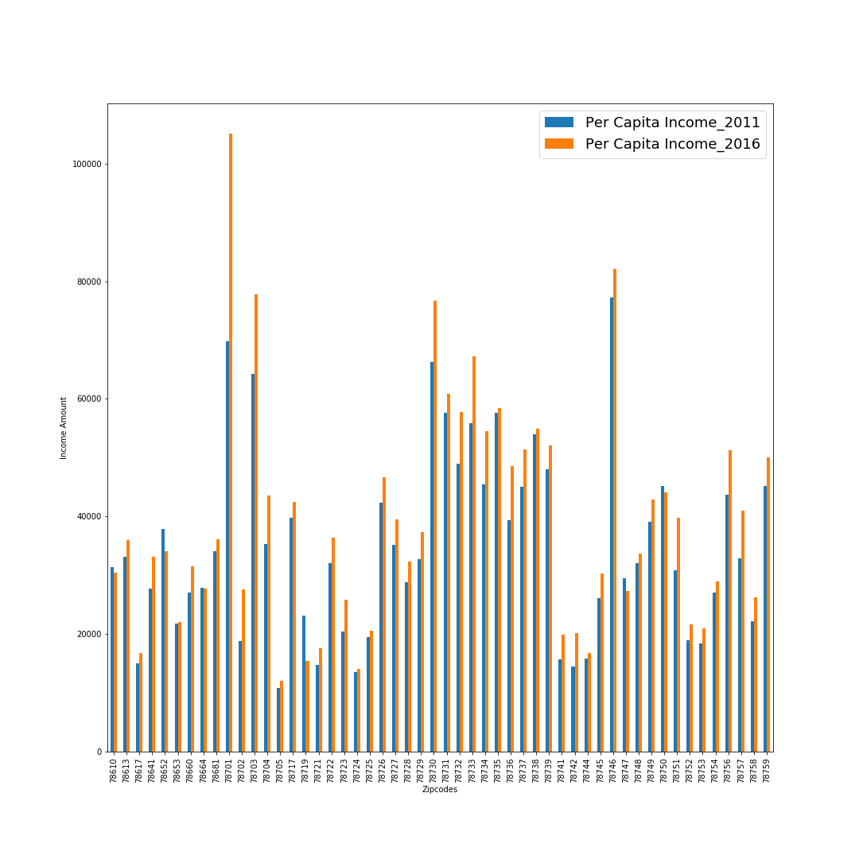
How have incomes changed by zip code from 2011 to 2016 (5 year look)?

Slide 4
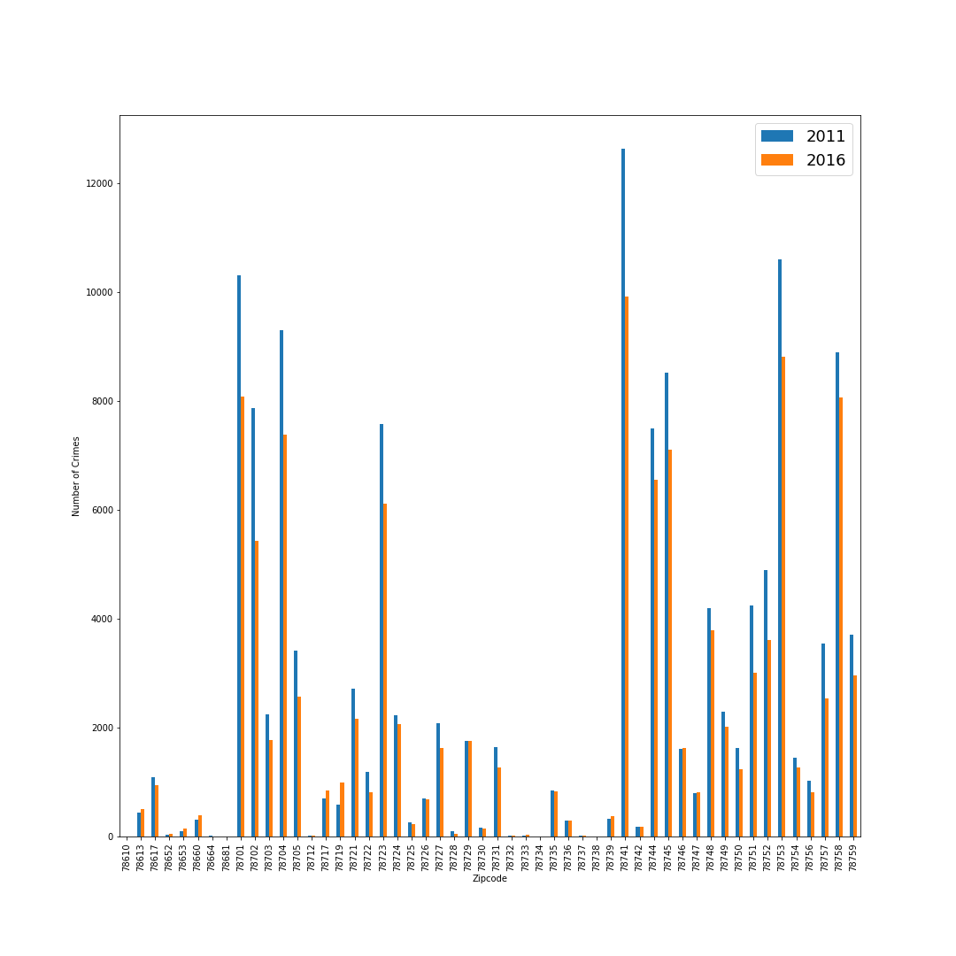
How have crime rates changed by zip code from 2011 to 2016? All of Austin?

Slide 5
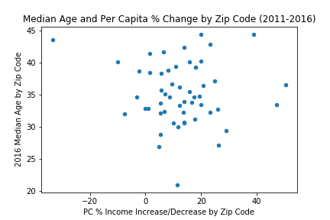
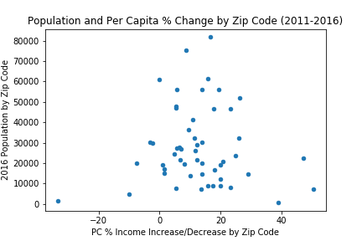
Does Age or population have an affect on income?

Slide 6
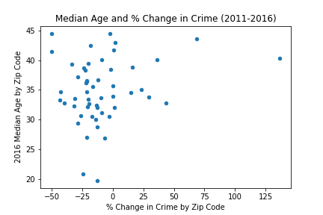
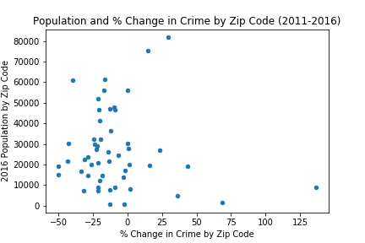
Does Age or population have an affect on crime?

Slide 7
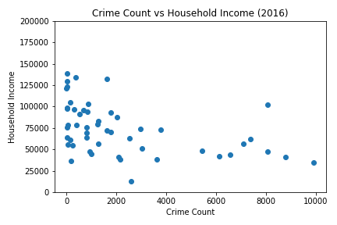
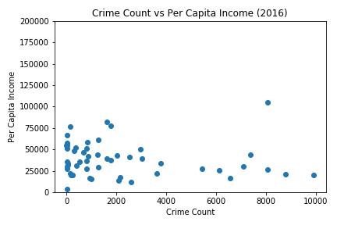
Is there a correlation between income rates (increase or decrease) and amount of crime?

Slide 8
Conclusions
For the vast majority of Austin zip codes, the income has increased from 2011-2016.
For the majority of the zip codes in all of Austin, crime rates decreased from 2011-2016.
There is no significant correlation between the age/population and income.
Neither age nor population have a significant effect on crime.
There is no correlation between income rates and crime rates.
For future reference or research, deeper investigation can be taken to research types of crime in zip codes.

Slide 9
Data Sources, Exploration and Analysis
Austintexas.gov (https://data.austintexas.gov/resource/mfej-x5pm.json)
Census (Census API)

